Slide 1
CS 416 Web Programming Core JSTL tag library
Dr. Williams
Central Connecticut State University

Slide 2
JSTL tag library
Collection of JSP tags that perform common tasks preventing the need to create custom tags
Examples
Conditional logic and iteration
Formatting
SQL for interacting with the database
XML tags for XML processing
Used in the same way as custom tags

Slide 3
Including core JSTL
Just like any other tag library the core JSTL tags must have an include statement as well
For core tags reference java site as uri
<%@taglib prefix="c" uri="http://java.sun.com/jsp/jstl/core" %>

Slide 4
Variables
For accessing tags in the core JSTL library the standard tag prefix is “c”
With core library you can define variable to be used within the page using:
<c:set var="myName" scope="session" value="${param.name}" />
Similar to being able to define the scope of bean (page,request,session,application) can define scope of variable

Slide 5
Output
The way variable should be output to the page is using:
<c:out value="${myName}" />
Why this rather than just ${myName}?
By using <c:out../> the JSP will escape any special characters such as HTML characters

Slide 6
Redirection
Similar to redirect within a servlet a JSP can redirect the browser using:
<c:redirect url=“mypage.jsp”/>

Slide 7
If statements with JSTL
<c:if test="${param.guess!='5'}">
You did not guess my number!
</c:if>
But there is no elseif or else using <c:if…

Slide 8
Logical expressions
Logical expressions for if and when is similar to logical expression in Java if statement
“!” is not
“==“ is equivelent
“&&” “||” and/or
There are a couple of additional ones as well
“empty myString” checks the string and returns true if the string is either null or has a length of 0
“E1?E2:E3” check condition in E1, if true evaluates E2 else evaluates E3

Slide 9
If else statements with JSTL
The syntax for if statements within JSTL is created using 3 tags
<c:choose>
<c:when test=“logical expression”>
<c:when test=“logical expression”>
<c:otherwise>
</c:choose>
<c:choose> indicates there will be a set of choices coming up defined by the when and otherwise tags
<c:when test=“logical expression”> is the if statement with the test being the condition to be checked
<c:otherwise> is equivalent to else

Slide 10
Choose syntax
<c:choose>
<c:when test="${empty name}">
No name specified
</c:when>
<c:when test="${name == 'John'}">
John rocks!
</c:when>
<c:otherwise>
<c:out value="Hi ${name}"/>
</c:otherwise>
</c:choose>

Slide 11
Choose example
EnterData.jsp
MyExample.jsp (c:out,if, choose, redirect)

Slide 12
Loops
Core JSTL provides functionality for performing loops using:
<c:forEach var=“item” items=“${myCollection}”>
This can be used for iterating through any java.util.Collection, array or java.util.Map
Within the forEach tags the variable item can then be used ${item}
Note for Maps the item will be the Map Entry, you would then access the key using ${item.key} and the value using ${item.value}

Slide 13
Tokenizing
To tokenize a string and loop through the values
<c:set var="myString" scope="request" value="Here is my delimited string" />
<c:forTokens items="${myString}" delims=" ,|" var="myToken">
<c:out value="Next token: ${myToken}"/><br/>
</c:forTokens>
var is the items is the String to be tokenized
delims is a string containing each character that should be a delimiter
var is the current token

Slide 14
MVC Example
Example3Entry.jsp
Example3Servlet (enhance and forward to JSP)
Example3Results (tokenizing, for loops)

Slide 15
Catching exceptions
Back at the beginning we talked about using errorPage=“error.jsp” to handle exceptions, exceptions can also be handled within the page
<c:catch var="e">
Some good content then create an exception<br/>
<Some bad code>
This is never reached because of the exception
</c:catch>
Content after catch
<c:out value=“exception ${e}/>

Slide 16
Formatting library
<%@taglib prefix="fmt" uri="http://java.sun.com/jsp/jstl/fmt" %>
Provides functions:
Internationalization
Formatting output (Dates, numbers)
Parsing text
Internationalization functions allow you to set page content to a properties files and based on the user’s locale retrieve content based on properties names

Slide 17
Internationalization
<fmt:setLocale value="en_US"/>
<fmt:message key='greeting'/><br/>
<fmt:message key='message'/><br/>
<fmt:setLocale value="es_ES"/>
<fmt:message key="greeting"/><br/>
<fmt:message key="message"/><br/>
Hello
How are you? Hola ¿Cómo estás?

Slide 18
Formatting/parsing
<fmt:parseDate value="04/02/1976" pattern="MM/dd/yyyy" var="myDate"/>
<fmt:parseNumber value="40,000.00" var="myNumber"/>
<fmt:formatDate value="${myDate}" pattern="M/d/yy"/><br/>
<fmt:formatNumber value="${myNumber}"/>

Slide 19
Example
index.jsp – all elements

Slide 20
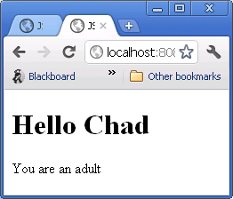
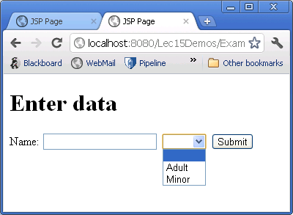
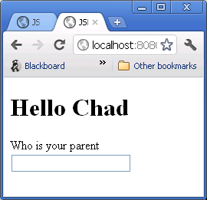
Example Conditional display
Use entry template Example2Entry.jsp
Create Example2Results.jsp
Use c:choose
Otherwise redirect to entry page

Slide 21
Free form – Halloween
Create a page that submits 3 entries:
text field - person’s name
Dropdown list – (2 options of costume)
Check box (3 options candy preference)
Have the target page use when to display different content for entries of each option
For text field – if the entry matches you name display a special greeting (if statement)
Drop down list – have 2 options if option 1 is picked display 1 image if option 2 is picked display a different image (when statement)
Display each of the options picked in a table (for loop)

Slide 22
Design the app
Bob’s Moving Company wants you to design a web application that doesn’t require refresh
As detailed estimates of belongings are provided complex calculations are performed to estimate num. boxes and moving van size
Based on van size needed, it looks up available dates and prices for those dates
Returns HTML rich site specific display of results
JUSTIFY YOUR DESIGN DECISIONS

Slide 23
Revise the app
CCSUMoveMe.com a moving company consolidator wants to be able to do the same as Kayak.com for moving quotes. They say Bob’s can be added if they provide their same functionality through their site, but they want to control the display.
How (if at all) would you change your architecture to meet this new need?

